Slide 1
Cloud Automation
Saintcon 2023
David Thurm
@PacketMonster
Notes:
A terraform provider is a plugin that allows terraform to interact with a cloud provider. They also have plugins for Vsphere, SaaS, and other APIs.
We grab this section from the terraform providers webpage. Just search terraform providers and click on azure.
Sometimes the version will change and may change the whole syntax and break your stuff. It happened to me while I was writing this presentation. The way security groups are done changed on me.
An example of a Feature is “prevent_deletion_if_contains_resources = false” This allows me to delete a resource group even if it has stuff in it. Sometimes a hard disk doesn’t get deleted because I configured the VM wrong.

Slide 2
Introduction
Cyber Security Architect, Accenture Federal Services
Cloud Smart Subject Matter Expert (SME)
Zero Trust SME for the Department of Energy
Recovering .edu IT
* Comments are all my own and not those of my employer
Notes:
A terraform provider is a plugin that allows terraform to interact with a cloud provider. They also have plugins for Vsphere, SaaS, and other APIs.
We grab this section from the terraform providers webpage. Just search terraform providers and click on azure.
Sometimes the version will change and may change the whole syntax and break your stuff. It happened to me while I was writing this presentation. The way security groups are done changed on me.
An example of a Feature is “prevent_deletion_if_contains_resources = false” This allows me to delete a resource group even if it has stuff in it. Sometimes a hard disk doesn’t get deleted because I configured the VM wrong.

Slide 3
Agenda
I will walk through the code and then hands on.
We will create, modify, and destroy workloads.
You will be able to go back into your lab and deploy a server instance today.
All code is in the GitHub repository.
We have 4 hours, so we have some bonus moderate and some advanced content as well.
Notes:
A terraform provider is a plugin that allows terraform to interact with a cloud provider. They also have plugins for Vsphere, SaaS, and other APIs.
We grab this section from the terraform providers webpage. Just search terraform providers and click on azure.
Sometimes the version will change and may change the whole syntax and break your stuff. It happened to me while I was writing this presentation. The way security groups are done changed on me.
An example of a Feature is “prevent_deletion_if_contains_resources = false” This allows me to delete a resource group even if it has stuff in it. Sometimes a hard disk doesn’t get deleted because I configured the VM wrong.

Slide 4
Why Automation
Time Savings
Doing things at Scale
Immutable Architecture

Slide 5

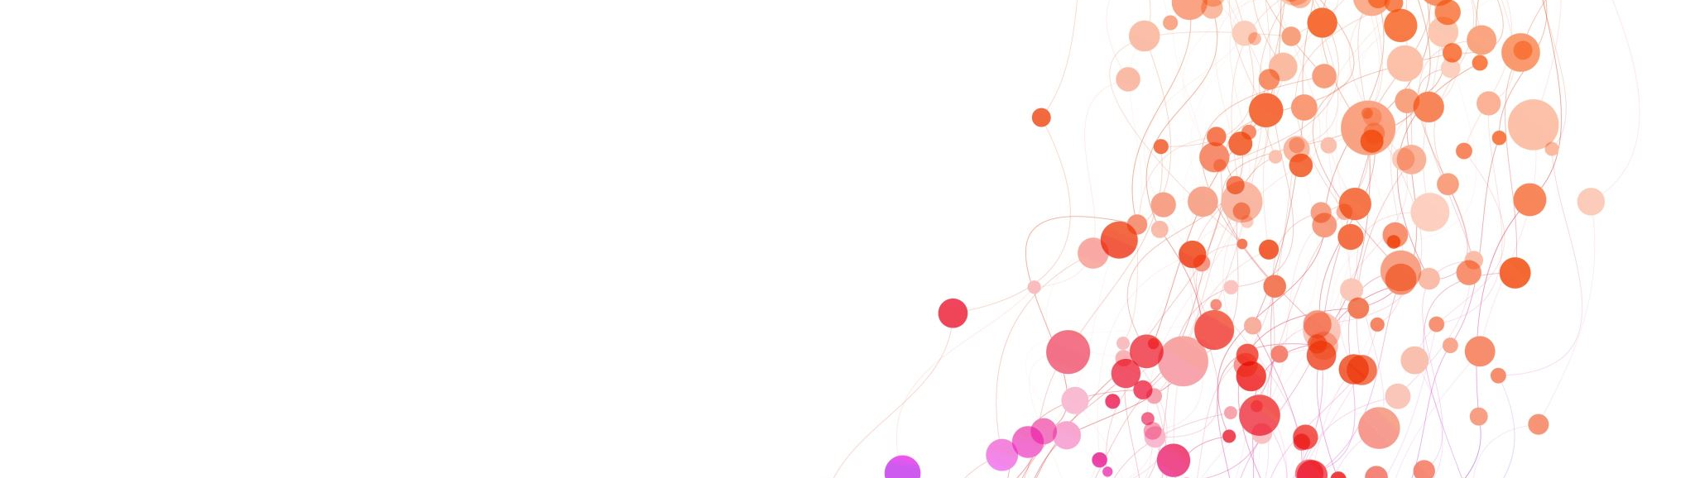
Demo/Hands On
GUI Configuration
Notes:
A terraform provider is a plugin that allows terraform to interact with a cloud provider. They also have plugins for Vsphere, SaaS, and other APIs.
We grab this section from the terraform providers webpage. Just search terraform providers and click on azure.
Sometimes the version will change and may change the whole syntax and break your stuff. It happened to me while I was writing this presentation. The way security groups are done changed on me.
An example of a Feature is “prevent_deletion_if_contains_resources = false” This allows me to delete a resource group even if it has stuff in it. Sometimes a hard disk doesn’t get deleted because I configured the VM wrong.

Slide 6

Intro to Terraform
Servers have no feelings
Notes:
A terraform provider is a plugin that allows terraform to interact with a cloud provider. They also have plugins for Vsphere, SaaS, and other APIs.
We grab this section from the terraform providers webpage. Just search terraform providers and click on azure.
Sometimes the version will change and may change the whole syntax and break your stuff. It happened to me while I was writing this presentation. The way security groups are done changed on me.
An example of a Feature is “prevent_deletion_if_contains_resources = false” This allows me to delete a resource group even if it has stuff in it. Sometimes a hard disk doesn’t get deleted because I configured the VM wrong.

Slide 7
Agenda – Intro to Terraform
Describe what Terraform is.
Directory Structure
Key Ingredients to an AWS EC2 deployment
GitHub Introduction
Basic Terraform Lab
Notes:
A terraform provider is a plugin that allows terraform to interact with a cloud provider. They also have plugins for Vsphere, SaaS, and other APIs.
We grab this section from the terraform providers webpage. Just search terraform providers and click on azure.
Sometimes the version will change and may change the whole syntax and break your stuff. It happened to me while I was writing this presentation. The way security groups are done changed on me.
An example of a Feature is “prevent_deletion_if_contains_resources = false” This allows me to delete a resource group even if it has stuff in it. Sometimes a hard disk doesn’t get deleted because I configured the VM wrong.

Slide 8
What is Terraform
Cloud Automation
Deploy your networks, Access Control Lists, Firewalls, WAFs, Servers, etc
Saves hours of your life.
Repeatable processes that are code reviewed.
Immutable Infrastructure (Zero Trust)
Fancy talk for you don’t patch you Nuke from orbit and redeploy clean instances (Servers).
Secure by Default
Pairs well with Ansible and Salt

Slide 9
File and Directory Structure
Recommended Minimum Files (even if empty)
Main.tf
Variables.tf
Outputs.tf
README.md
License (Optional)
Directories
./modules
./terraform
Notes:
A terraform provider is a plugin that allows terraform to interact with a cloud provider. They also have plugins for Vsphere, SaaS, and other APIs.
We grab this section from the terraform providers webpage. Just search terraform providers and click on azure.
Sometimes the version will change and may change the whole syntax and break your stuff. It happened to me while I was writing this presentation. The way security groups are done changed on me.
An example of a Feature is “prevent_deletion_if_contains_resources = false” This allows me to delete a resource group even if it has stuff in it. Sometimes a hard disk doesn’t get deleted because I configured the VM wrong.

Slide 10

Key Ingredients / Requirements
provider
aws_vpc
aws_internet_gateway
aws_subnet
aws_route_table
aws_route_table_association
aws_security_group
aws_instance
Notes:
This is the only meme because I had too much stuff on each slide.
My wife is a pastry chef, so I look at this as the individual ingredients you need to make a server deployment.

Slide 11
Deployment Steps
AWS Login
Git pull
Edit Code
Run Terraform

Slide 12

Github
Git clone is your friend

Slide 13
GitHub Repo
Clone the Repo
git clone https://github.com/towerindustries/saintcon23.git
Git add .
Adds all the change files to the local git configuration.
Git commit –m “first commit”
Prepares to push all your changes to GitHub (stays local)
Git push
Pushes all of your changes to Github Repository
CoPilot (AI Coding)
For now, this is all you need

Slide 14

Basic Terraform Lab
/intro_to_terraform/README.md

Slide 15

Moderately Terraform
Now you have some of Cattle

Slide 16
Agenda – Moderate Terraform
Brief Introduction to the State File
Starting Configuration
/moderate_terraform/moderate_base/config
Creating Terraform Files
Create providers.tf
Create data.tf
Create locals.tf
Create variables.tf
Create terraform.tfvars
Moving/using nginxserver_amazon_deploy.sh
Notes:
A terraform provider is a plugin that allows terraform to interact with a cloud provider. They also have plugins for Vsphere, SaaS, and other APIs.
We grab this section from the terraform providers webpage. Just search terraform providers and click on azure.
Sometimes the version will change and may change the whole syntax and break your stuff. It happened to me while I was writing this presentation. The way security groups are done changed on me.
An example of a Feature is “prevent_deletion_if_contains_resources = false” This allows me to delete a resource group even if it has stuff in it. Sometimes a hard disk doesn’t get deleted because I configured the VM wrong.

Slide 17

The State File
Has broken people's souls

Slide 18
State File - terraform.tfstate
Local State File
Does not like friends
Not Scalable
Remote State File
Best Practice
Terraform Cloud
AWS RDS / S3 Bucket
Lives here: ./terraform.state
Json file with current cloud deployment settings
Does not know if you made a change in the GUI.
Do not modify by hand (unless you are brave and/or crazy)
Microsoft aztfexport
https://github.com/Azure/aztfexport

Slide 19

Providers Lab
/moderate_terraform/providers

Slide 20
Agenda – Providers
Setting AWS Provider Version
https://registry.terraform.io/browse/providers
Terraform Version
AWS Region
Notes:
A terraform provider is a plugin that allows terraform to interact with a cloud provider. They also have plugins for Vsphere, SaaS, and other APIs.
We grab this section from the terraform providers webpage. Just search terraform providers and click on azure.
Sometimes the version will change and may change the whole syntax and break your stuff. It happened to me while I was writing this presentation. The way security groups are done changed on me.
An example of a Feature is “prevent_deletion_if_contains_resources = false” This allows me to delete a resource group even if it has stuff in it. Sometimes a hard disk doesn’t get deleted because I configured the VM wrong.

Slide 21
Providers Results
terraform {
required_providers {
aws = {
source = "hashicorp/aws"
version = "5.21.0"
}
}
required_version = ">= 1.6.1"
}
provider "aws" {
# Configuration options
region = "us-east-1"
}

Slide 22

Data Lab
/moderate_terraform/data

Slide 23
Agenda – Data
Search AWS available AMIs
Amazon 2023 AMI
Output that AMI to be used later
Add the Amazon 2023 AMI to the EC2 Instance
Notes:
A terraform provider is a plugin that allows terraform to interact with a cloud provider. They also have plugins for Vsphere, SaaS, and other APIs.
We grab this section from the terraform providers webpage. Just search terraform providers and click on azure.
Sometimes the version will change and may change the whole syntax and break your stuff. It happened to me while I was writing this presentation. The way security groups are done changed on me.
An example of a Feature is “prevent_deletion_if_contains_resources = false” This allows me to delete a resource group even if it has stuff in it. Sometimes a hard disk doesn’t get deleted because I configured the VM wrong.

Slide 24
Data Results
data "aws_ami" "latest_amazon_linux_2023" {
most_recent = true
filter {
name = "name"
values = ["al2023-ami-minimal-2023*"]
}
filter {
name = "owner-id"
values = ["137112412989"]
}
filter {
name = "architecture"
values = ["x86_64"]
}
filter {
name = "virtualization-type"
values = ["hvm"]
}
filter {
name = "owner-alias"
values = ["amazon"]
}
filter {
name = "state"
values = ["available"]
}
}
output "latest_amazon_linux_2023_ami_id" {
value = data.aws_ami.latest_amazon_linux_2023.id
}

Slide 25
Data (main.tf) Results
resource "aws_instance" "example" {
ami = data.aws_ami.latest_amazon_linux_2023.id
instance_type = "t2.micro"
key_name = "dev-example-key"
subnet_id = aws_subnet.example.id
tags = {
Name = "dev-amazon2023"
}

Slide 26

Locals Lab
/moderate_terraform/locals

Slide 27
Agenda – Locals
Setup Reusable Common Tags
Name
Service Name
Environment
Terraform Code
Setup Reusable Specific Tags
Network
Security
VPC
Ec2
Apply these tags to AWS “resources” in /main.tf
Notes:
A terraform provider is a plugin that allows terraform to interact with a cloud provider. They also have plugins for Vsphere, SaaS, and other APIs.
We grab this section from the terraform providers webpage. Just search terraform providers and click on azure.
Sometimes the version will change and may change the whole syntax and break your stuff. It happened to me while I was writing this presentation. The way security groups are done changed on me.
An example of a Feature is “prevent_deletion_if_contains_resources = false” This allows me to delete a resource group even if it has stuff in it. Sometimes a hard disk doesn’t get deleted because I configured the VM wrong.

Slide 28
Locals Results
locals {
name = "dev-amazon2023"
service_name = "example"
environment = "dev"
terraform_code = "moderate_locals"
}
locals {
# Common tags to be assigned to all resources
common_tags = {
Name = local.name
Service = local.service_name
Environment = local.environment
Terraform = local.terraform_code
}
network_tags = merge(local.common_tags, {
department = "devsecops"
owner = "dev.at.saintcon.org"
})
security_tags = merge(local.common_tags, {
department = "network-team"
owner = "noc.at.saintcon.org"
Name = "${local.environment}-${local.name}-sg"
})
vpc_tags = merge(local.common_tags, {
department = "network-team"
owner = "noc.at.saintcon.org"
Name = "${local.environment}-${local.name}-vpc"
})
ec2_tags = merge(local.common_tags, {
department = "network-team"
owner = "noc.at.saintcon.org"
Name = "${local.environment}-${local.name}-ec2"
})
}

Slide 29
Locals (main.tf) Results
resource "aws_internet_gateway" "example" {
tags = local.network_tags
}
resource "aws_internet_gateway" "example" {
tags = local.network_tags
}
resource "aws_subnet" "example" {
tags = local.network_tags
}
resource "aws_route_table" "example" {
tags = local.network_tags
}
resource "aws_security_group" "example" {
tags = local.security_tags
}
resource "aws_instance" "example" {
tags = local.ec2_tags
}

Slide 30

Variables Lab
/moderate_terraform/variables

Slide 31
Agenda – Variables
Create variables.tf
Copy update variables file with correct variables
Change Security Group Variable to reflect your current IP.
Modify providers.tf
Change region to a variable
Modify main.tf
VPC
Subnet
Security Group
EC2
Notes:
A terraform provider is a plugin that allows terraform to interact with a cloud provider. They also have plugins for Vsphere, SaaS, and other APIs.
We grab this section from the terraform providers webpage. Just search terraform providers and click on azure.
Sometimes the version will change and may change the whole syntax and break your stuff. It happened to me while I was writing this presentation. The way security groups are done changed on me.
An example of a Feature is “prevent_deletion_if_contains_resources = false” This allows me to delete a resource group even if it has stuff in it. Sometimes a hard disk doesn’t get deleted because I configured the VM wrong.

Slide 32
Variables (variables.tf) Results
Too long to put in a slide

Slide 33
Variables (providers.tf) Results
terraform {
required_providers {
aws = {
source = "hashicorp/aws"
version = "5.21.0"
}
}
required_version = "~> 1.5.7"
}
provider "aws" {
# Configuration options
region = var.region
}

Slide 34
Variables (main.tf) Results
Too long to put in a slide

Slide 35

Tfvars

Slide 36
Terraform.tfvars
Overwrites the defaults in the variables file.
Create variable values in terraform.tfvars

Slide 37
Tfars (terraform.tfvars) Results
availability_zone = "us-east-1a"
region = "us-east-1"
vpc_cidr_block = "10.0.0.0/16"
subnet_cidr_block = "10.0.0.0/24"
sg_cidr_blocks_allow_ssh = ["161.28.24.210/32"]
sg_cidr_blocks_allow_http = ["161.28.24.210/32"]
sg_cidr_blocks_allow_https = ["161.28.24.210/32"]
instance_type = "t2.micro"
key_name = "dev-example-key"
volume_size = "30"
volume_type = "gp3"

Slide 38
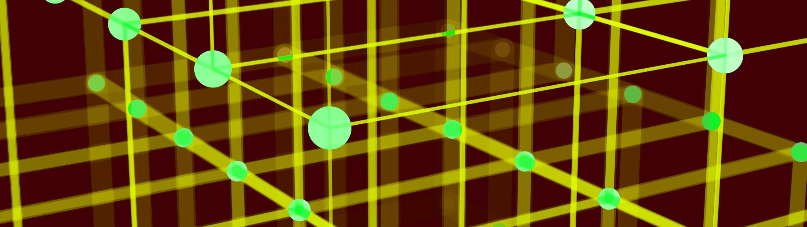
Advanced Terraform
Now you think you are a programmer

Slide 39
Agenda – Advanced Terraform
Terraform Deploy base config
/advanced_terraform/advanced_base_config
Remote State
Outputs
Advanced Data
Intro to Modules
Advanced Modules
Notes:
A terraform provider is a plugin that allows terraform to interact with a cloud provider. They also have plugins for Vsphere, SaaS, and other APIs.
We grab this section from the terraform providers webpage. Just search terraform providers and click on azure.
Sometimes the version will change and may change the whole syntax and break your stuff. It happened to me while I was writing this presentation. The way security groups are done changed on me.
An example of a Feature is “prevent_deletion_if_contains_resources = false” This allows me to delete a resource group even if it has stuff in it. Sometimes a hard disk doesn’t get deleted because I configured the VM wrong.

Slide 40

Deploy Base Config
/advanced_terraform/advanced_base_config

Slide 41

Remote State
/advanced_terraform/remote_state

Slide 42
Remote State Agenda
Describe the code in /remote_state/main.tf
Deploy remote state database and S3 changes
Adjust providers.tf for future configurations to reflect remote state.

Slide 43

Outputs
/advanced_terraform/outputs.tf

Slide 44
Outputs Agenda
Sole purpose is to help organize and keep your code dry.
Used to store outputs for use as additional inputs in terraform.
Used to output to the screen.

Slide 45

Advanced Data
/advanced_terraform/advanced_data

Slide 46
Advanced Data Agenda
Reuse the AMI data search
Update outputs.tf with AMI output and Public IP output.
Update locals.tf with a new second_server tag.
Pull Existing VPC info from AWS and update outputs.tf.
Pull existing Subnet info from AWS and update outputs.tf.
Pull existing Subnet data and update outputs.tf.
Create a new main.tf just for our new EC2 second_server instance.
The README.md is busted a little

Slide 47

Intro to Modules
/advanced_terraform/intro_to_modules

Slide 48
Intro to Modules Agenda Part 1
No changes to provider.tf.
Only include region and availability zone (az) in variables.tf.
Create Module Directories
/modules/ami_amazon2023
/modules/ec2
/modules/networking
/modules/security_groups
Create new files for each module.
main.tf, variables.tf, data.tf,outputs.tf.

Slide 49
Intro to Modules Agenda Part 2
Create new files for root core files.
Main.tf, locals.tf, outputs.tf, providers.tf, variables.tf
Move over post install bash script nginxserver_amazon_deploy.sh
Deploy with reusable modules.

Slide 50

Advanced Modules

Slide 51
Advanced Modules Agenda
Modify modules source to the GitHub Module Repo.
Change sources to GitHub repo modules.

Slide 52
Questions?
Contract info:
@packetmonster (Saint Discord)
davidthurm (Linkedin)

